Slide 1
Ad_Hoc Insights
Consumer Goods
LinkedIn - http://www.linkedin.com/in/ingnikhilgill
Portfolio - https://sites.google.com/view/nikhilgill
Github - https://github.com/nikhilgill

Slide 2
About Company
Gilla Hardwares (a fictional company) has established itself as a leading computer hardware manufacturer in India, with a strong presence in 26 other countries as well.
74 Customers all over the world
73 products under company’s Brand
3 major divisions (Networking & Storage, PC, Peripherals & Accessories)

Slide 3
Company’s Objectives
Company’s management wants insights to make quick and smart data-informed decisions
Company wants to expand their data analytics team by adding several junior data analysts.
Their data analytics director wanted to hire someone who is good at both tech and soft skills.

Slide 4
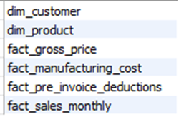
About Data
Company’s Data is stored in 6 tables
dim_customer
dim_product
fact_gross_price
Fact_manufacturing_cost
fact_pre_invoice_deductions
fact_sales_monthly

Slide 5
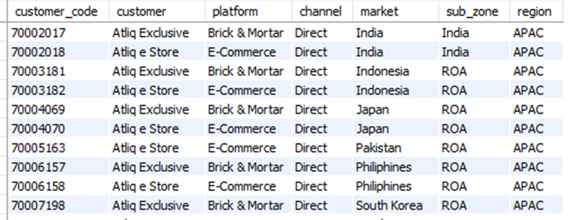

About Data in tables
dim_customer (7 columns, 209 rows)

Slide 6
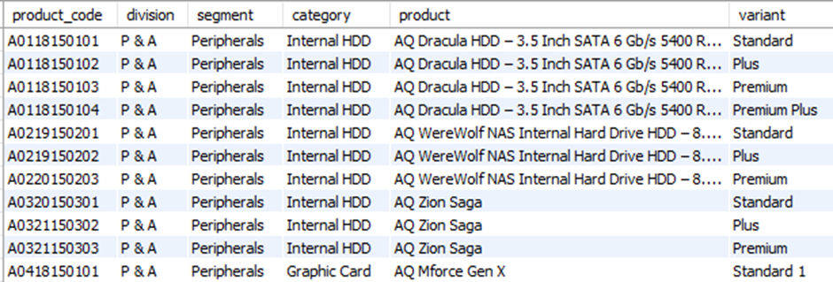

About Data in tables
dim_product (6 columns, 397 rows)

Slide 7
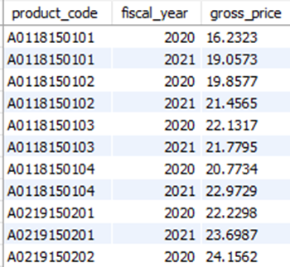

About Data in tables
fact_gross_price (3 columns, 579 rows)

Slide 8
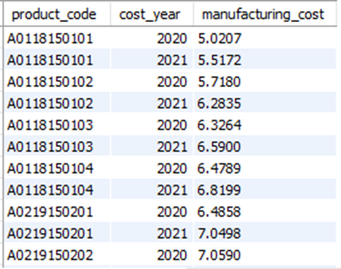
About Data in tables
fact_manufacturing_cost (3 columns, 579 rows)

Slide 9
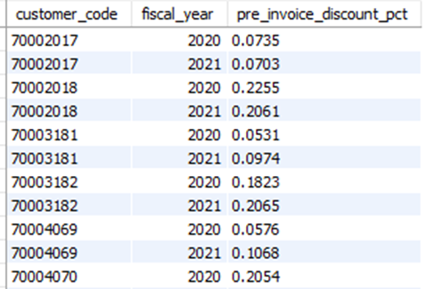

About Data in tables
fact_pre_invoice_deductions (3 columns, 418 rows)

Slide 10
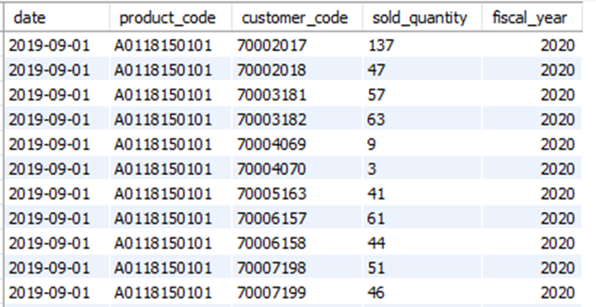

About Data in tables
fact_sales_monthly (5 columns, 971631 rows)

Slide 11


Request From Company’s Management
Provide the list of markets in which customer "Atliq Exclusive" operates its business in the APAC region.

Slide 12
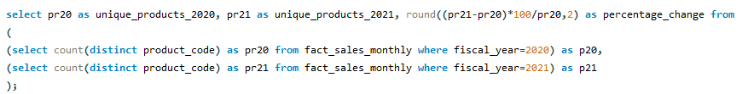

Request From Company’s Management
What is the percentage of unique product increase in 2021 vs. 2020? The final output contains fields - unique_products_2020, unique_products_2021, percentage_chg

Slide 13

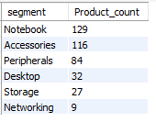
Request From Company’s Management
Provide a report with all the unique product counts for each segment and sort them in descending order of product counts. The final output contains 2 fields, segment product_count

Slide 14
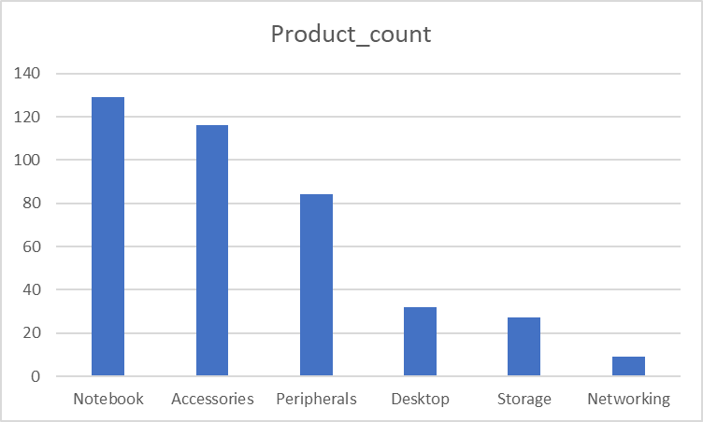

Slide 15
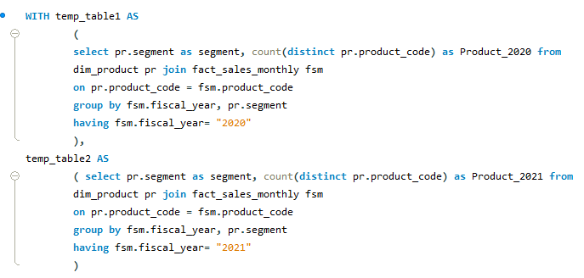
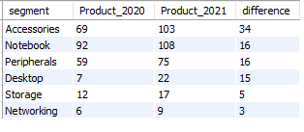
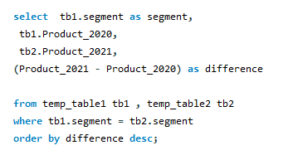
Request From Company’s Management
Follow-up: Which segment had the most increase in unique products in 2021 vs 2020? The final output contains these fields, segment product_count_2020 product_count_2021 difference

Slide 16
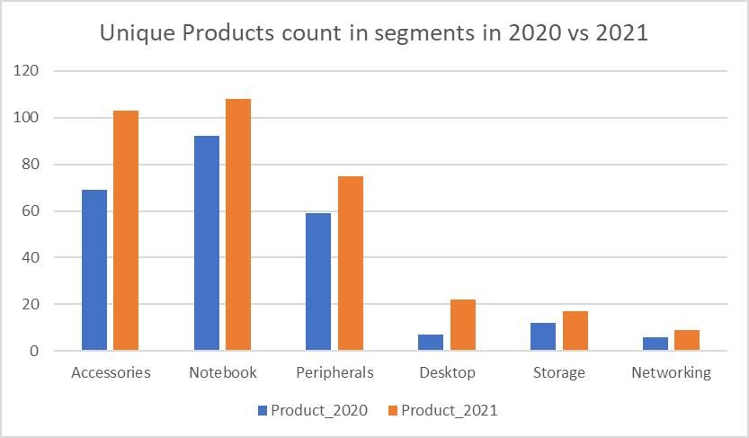

Slide 17
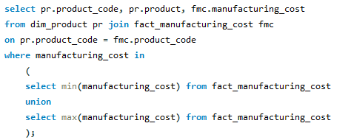

Request From Company’s Management
Get the products that have the highest and lowest manufacturing costs. The final output should contain these fields, product_code product manufacturing_cost

Slide 18
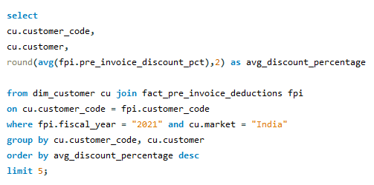
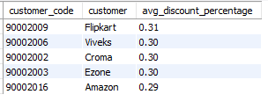
Request From Company’s Management
Generate a report which contains the top 5 customers who received an average high pre_invoice_discount_pct for the fiscal year 2021 and in the Indian market. The final output contains these fields, customer_code customer average_discount_percentage

Slide 19
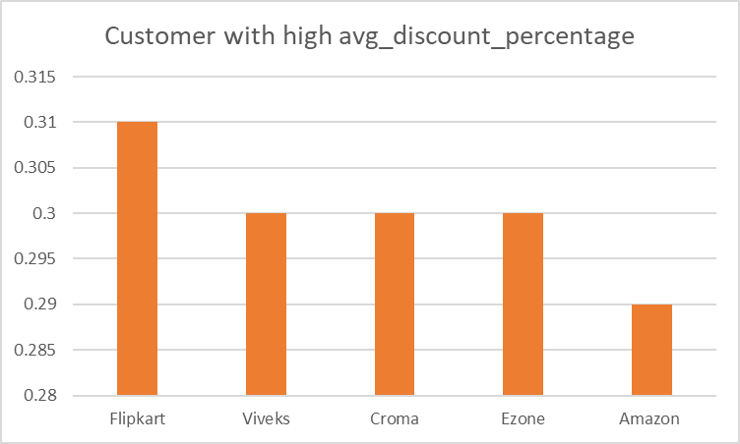

Slide 20
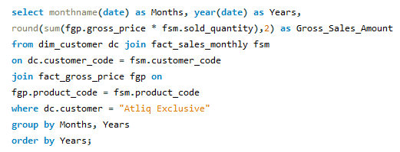
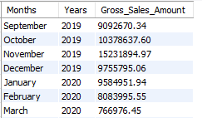
Request From Company’s Management
Get the complete report of the Gross sales amount for the customer “Atliq Exclusive” for each month. This analysis helps to get an idea of low and high-performing months and take strategic decisions. The final report contains these columns: Month Year Gross sales Amount

Slide 21
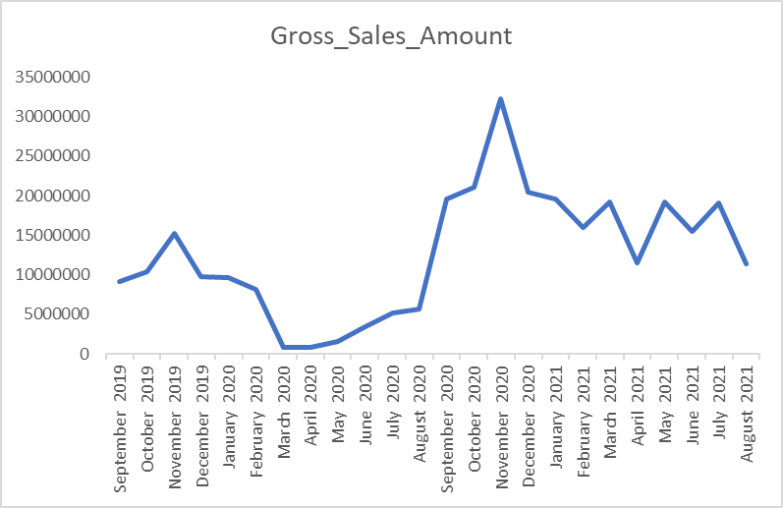

Slide 22
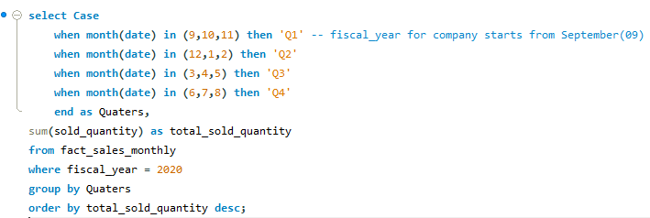
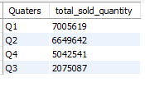
Request From Company’s Management
In which quarter of 2020, got the maximum total_sold_quantity? The final output contains these fields sorted by the total_sold_quantity, Quarter total_sold_quantity

Slide 23
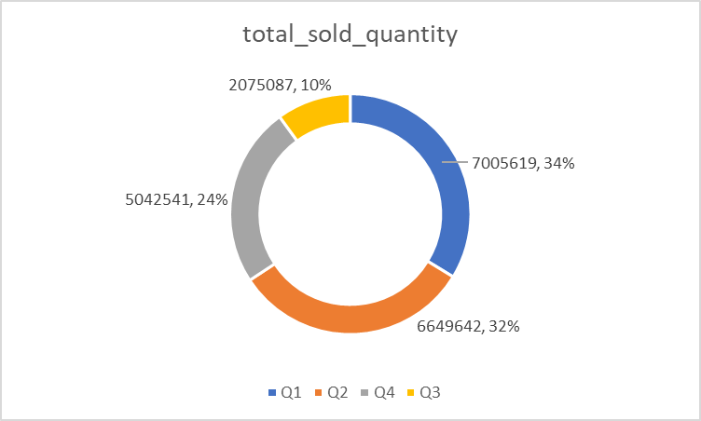

Slide 24
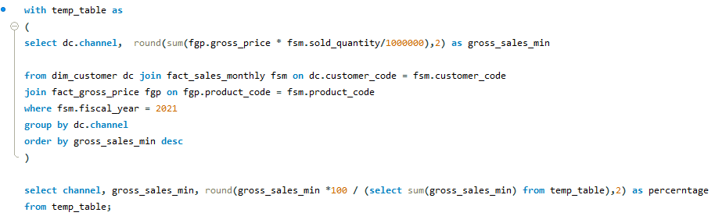

Request From Company’s Management
Which channel helped to bring more gross sales in the fiscal year 2021 and the percentage of contribution? The final output contains these fields, channel gross_sales_mln percentage

Slide 25
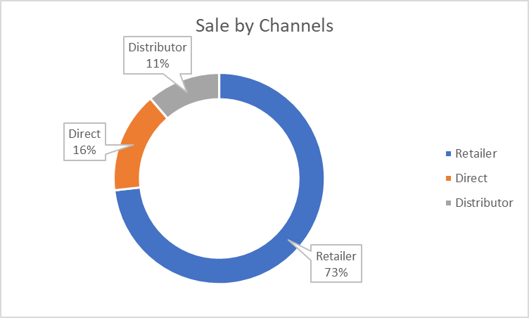

Slide 26
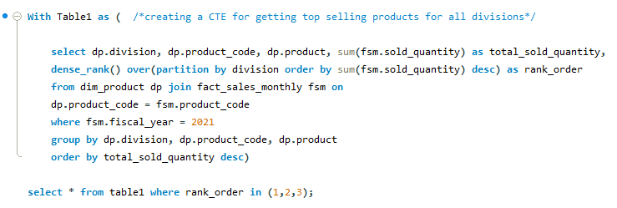
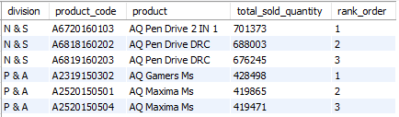
Request From Company’s Management
Get the Top 3 products in each division that have a high total_sold_quantity in the fiscal_year 2021? The final output contains these fields, division product_code product, total_sold_quantity rank_order

Slide 27
Thanks
LinkedIn - http://www.linkedin.com/in/ingnikhilgill
Portfolio - https://sites.google.com/view/nikhilgill
GitHub - https://github.com/nikhilgill

